Slide 1
Tutorial 5 Working with the Box Model

Slide 2
Objectives 5.1
Understand the box model
Create padding, margins, and borders
Wrap text around an image
Float a block-level element

Slide 3
Objectives 5.2
Use the background properties
Create a background image for a list
Create an external style sheet
Link to an external style sheet

Slide 4
The Box Model
The CSS box model describes the imaginary boxes that are formed around elements in a Web page.
The box model consists of four parts: a content area, padding, borders, and margins.
The content area is the area that contains the box content: text or an image.
The box properties are used to add white space and a border around the content.

Slide 5
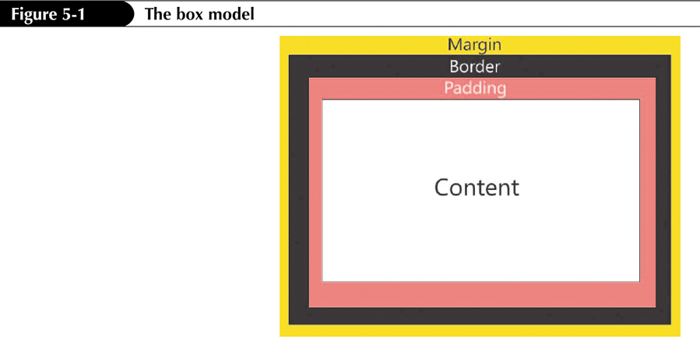
The Box Model

Slide 6
The Box Properties
The three most commonly used CSS box properties are:
padding
border
margin
The other two properties are:
width
length

Slide 7
Padding Properties
Padding is the internal white space that surrounds the contents of an element.
The padding properties control this internal white space.
By default, the content of an element does not have padding.
All major Web browsers add varying amounts of padding by default.

Slide 8
Padding Properties
To set the padding within an element, use:
padding: width;
To set the padding for each side individually, the following four properties can be used:
padding-top
padding-right
padding-bottom
padding-left
The shorthand property can be used:
padding: top right bottom left;

Slide 9
Padding and Margin Properties
Values for both the padding and the margin properties can be expressed using:
em (em values)
px (pixels)
mm (millimeters)
cm (centimeters)
in (inches)
% (percentage of the container element)

Slide 10
Margin Properties
The margin properties control the external white space, which is the white space outside the border.
Every element has margins.
The margin properties are often used to create a white space around images.

Slide 11
Margin Properties
To set the margin space around an element, use:
margin: width;
To set the padding for each side individually, the following four properties can be used:
margin-top
margin-right
margin-bottom
margin-left
The shorthand property can be used:
margin: top right bottom left;

Slide 12
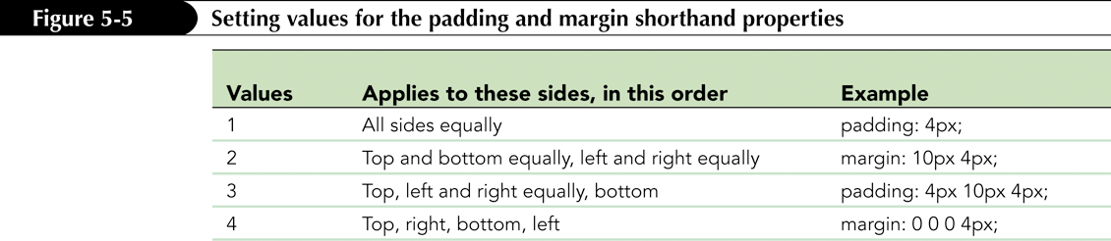
Using the padding and margin Shorthand Properties

Slide 13
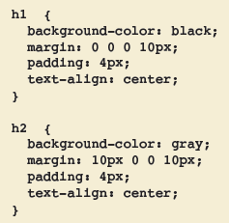
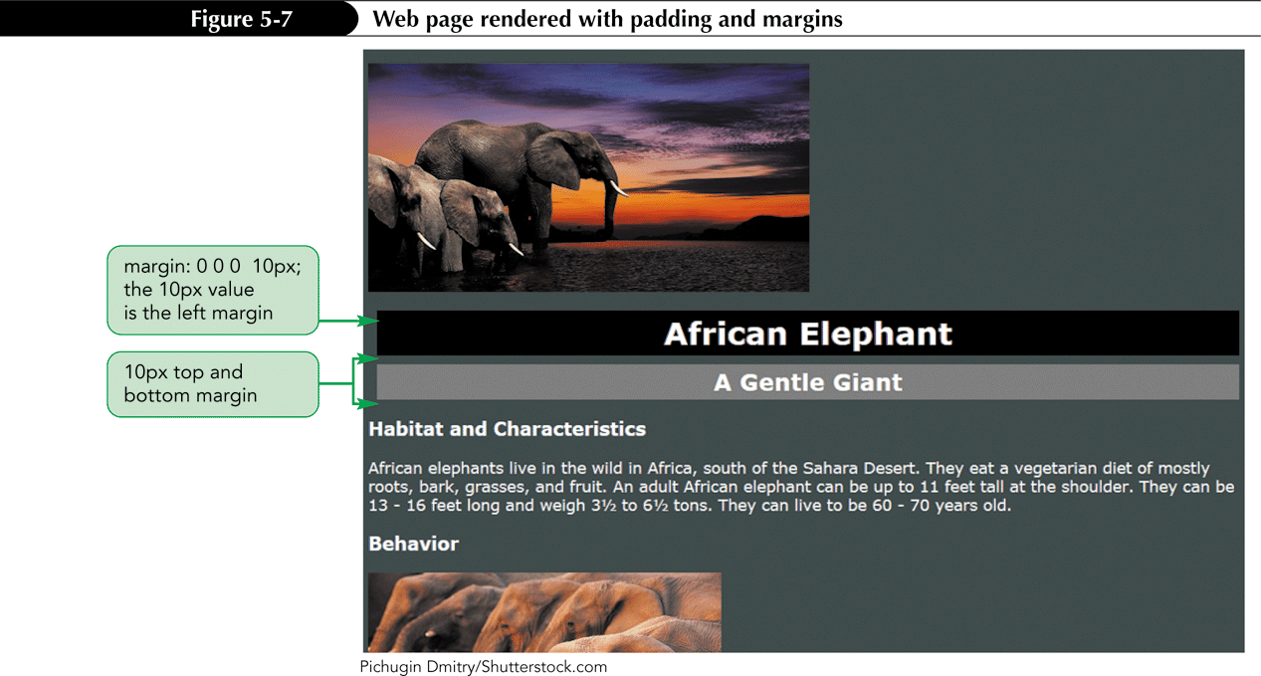
Example of padding and margin Shorthand Properties

Slide 14
Border Properties
The border properties are used to place a decorative border around the contents and padding of an element.
The border is located between the padding and the margin.
You can change a border’s:
style
color
width

Slide 15
Setting Border Style
The border-style value can be any one of the following: – solid – double – dotted – dashed – groove – ridge – inset – outset – none (default)
There are five border-style properties:
border-top-style
border-right-style
border-bottom-style
border-left-style
border-style (shorthand property)

Slide 16
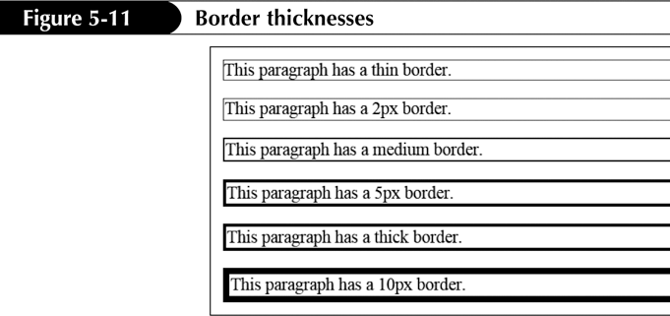
Setting Border Width
Border thickness can be expressed using the keywords: – thin – medium – thick
There are five border-width properties:
border-top-width
border-right-width
border-bottom-width
border-left-width
border-width (shorthand property)

Slide 17
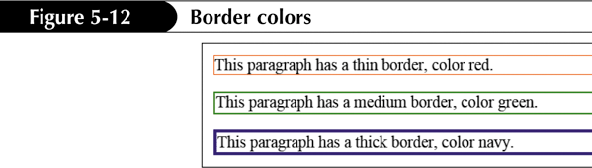
Setting Border Color
The border color can be a named color, a hex value, or an RGB value.
There are five border-color properties:
border-top-color
border-right-color
border-bottom-color
border-left-color
border-color (shorthand property)

Slide 18
Border Shorthand Properties
The following three properties change the border style, width, or color for all four borders:
border-color
border-style
border-width
The following four properties change the border style, width, or color for an individual border:
border-top
border-right
border-bottom
border-left

Slide 19
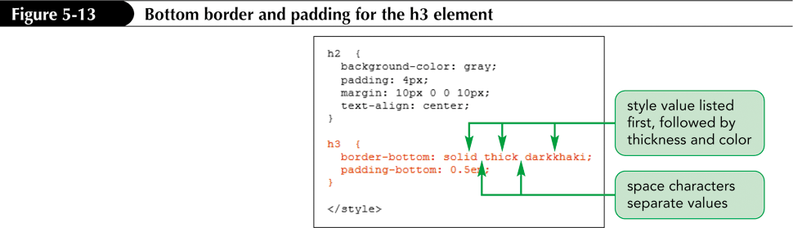
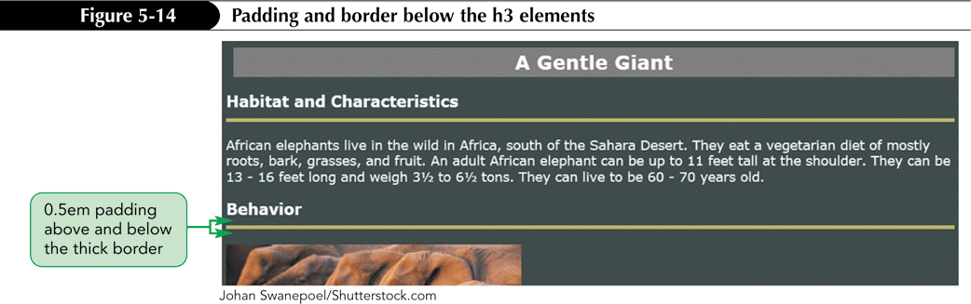
Border Shorthand Properties

Slide 20
The float property
The float property is used to position boxes on the page and to wrap content, such as text, around a box.
To float an element, use the style: float: position;
The position can have the following values:
left
right
none

Slide 21
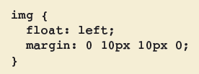
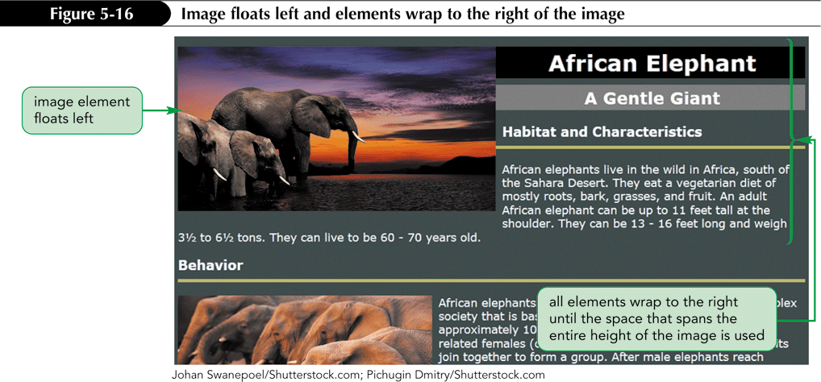
The float property

Slide 22
The clear Property
The clear property is used to position the content of an element below another element that has been floated.
This is also called clearing past an element.
To clear past an element, use the style: clear: position;
The position can have the following values:
left
right
both

Slide 23
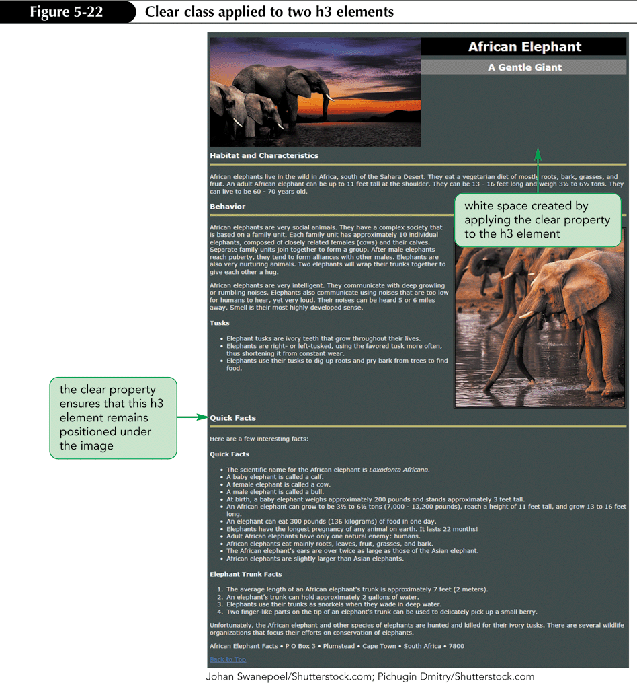

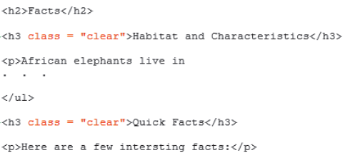
The clear Property

Slide 24
The Background Properties
The background properties set the background effects for an element.
The following properties can be used: - background-image - background-color - background-position - background-repeat - background-attachment - background
For the last one, values must be listed in the following order: image color position repeat attachment

Slide 25

The background-image Property
The background-image property is used to fill the background of an element with an image.
If this property is used with the body element as a selector, and if the image is repeated both horizontally and vertically (the default), then the background image will repeat to occupy the entire Web page.

Slide 26


The background-position Property
The background-position property allows you to position a background image in different locations within its container element.
The container element could be body, head, or footer.

Slide 27
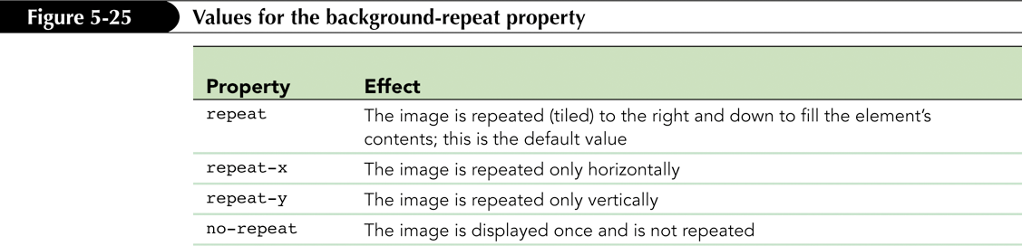
The background-repeat Property
The background-repeat property can be used to have copies of an image appear behind an element horizontally, vertically, or both.
Repeating an image is known as tiling.

Slide 28
The background-attachment Property
The background-attachment property allows you to set the behavior of the background image with respect to scrolling.
This property accepts two values:
scroll (the default value) – image scrolls down the page
fixed – image stays in place and the text scrolls over the image as the user scrolls down the page

Slide 29

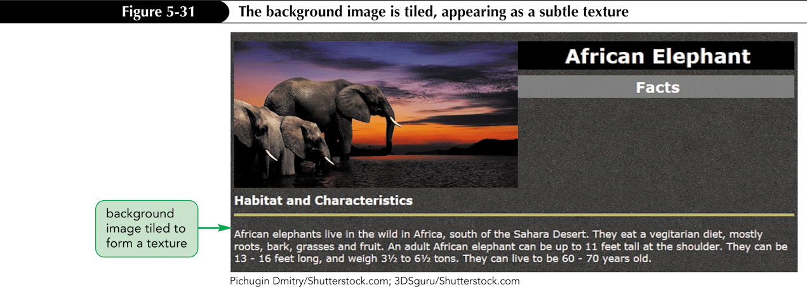
The background Property

Slide 30
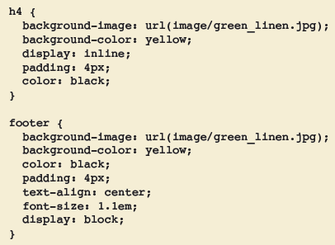
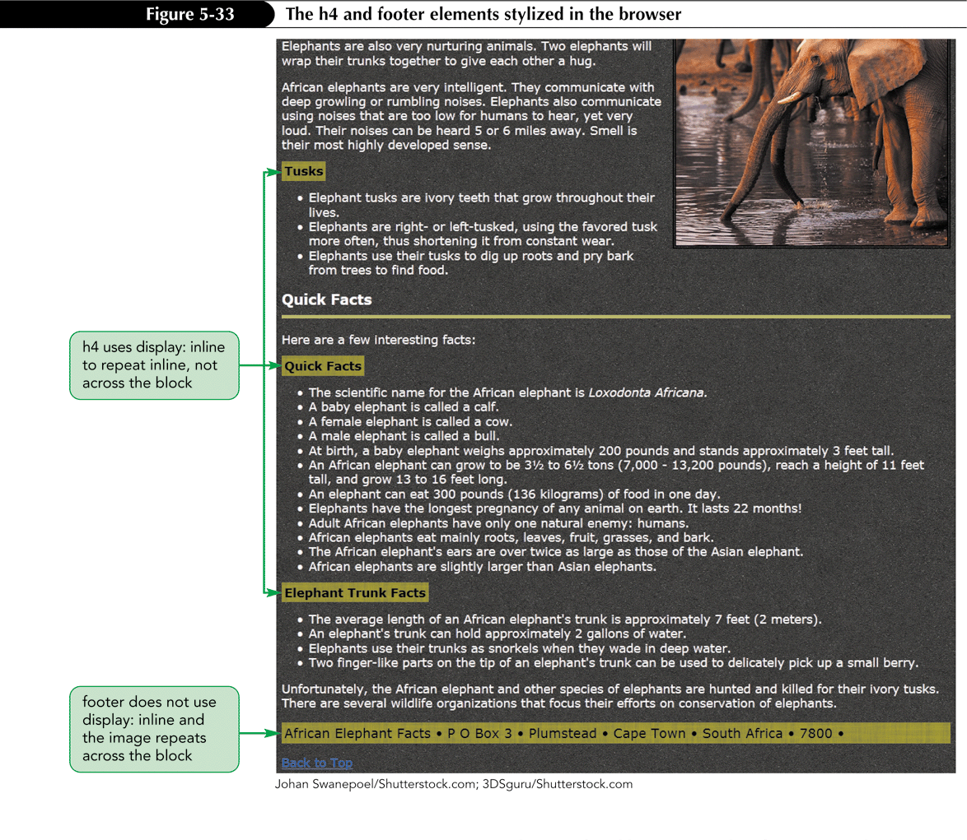
The background Property

Slide 31
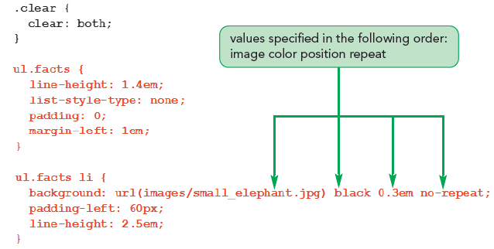

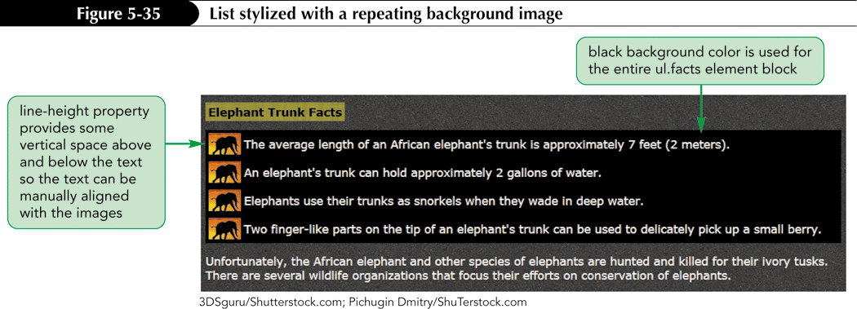
Using a Background Image for List Items

Slide 32
Resolving Style Conflicts
The term cascading in CSS refers to the methods used to determine which style rules apply if more than one rule styles the same element.
Style precedence determines which styles have priority.
There are five possible sources for styles.

Slide 33
Resolving Style Conflicts
The order of precedence (from highest precedence to lowest) is as follows:
User-defined styles
Inline styles
Embedded style sheet styles
External style sheet styles
The browser’s style sheet (the browser’s default styles)

Slide 34
Creating an External Style Sheet
Create a new file for the external style sheet.
Include a CSS comment.
Cut the CSS styles from the embedded style sheet and paste the code into the CSS file.
In the head section of the HTML file, enter code to link to the external CSS: <link rel="stylesheet" href="filename.css" type="text/css" /> where filename.css is the name of the external style sheet file.

